Slide 1
COMPUTER ORGANISATION
REGISTER TRANSFER LANGUAGE

Slide 2
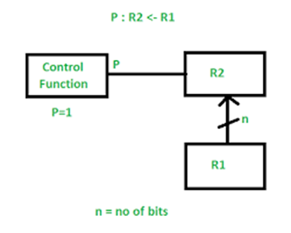
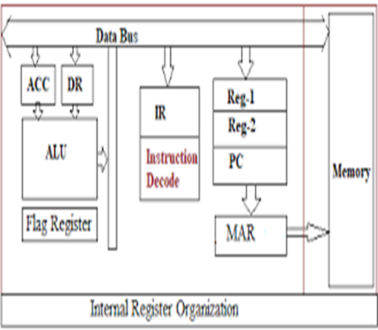
What Is Register Transfer Language?
The symbolic notation used to describe the micro-operation transfers amongst registers is called Register transfer language. The term register transfer means the availability of hardware logic circuits that can perform a stated micro-operation and transfer the result of the operation to the same or another register. The word language is borrowed from programmers who apply this term to programming languages. This programming language is a procedure for writing symbols to specify a given computational process.

Slide 3

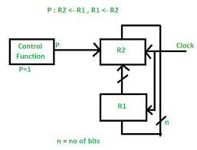
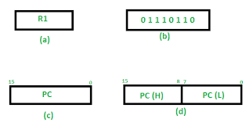
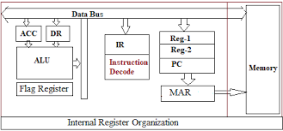
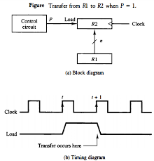
Register Transfer Language

Slide 4
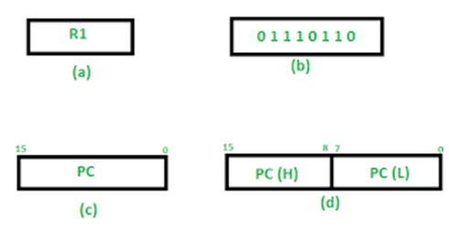
Register Transfer
Information transferred from one register to another is designated in symbolic form by means of replacement operator.
R2 ← R1
It denotes the transfer of the data from register R1 into R2.
Normally we want the transfer to occur only in predetermined control condition. This can be shown by following if-then statement: if (P=1) then (R2 ← R1)

Slide 5
Micro-Operations
The operations executed on data stored in registers are called micro-operations. A micro-operation is an elementary operation performed on the information stored in one or more registers.
Example: Shift, count, clear and load.

Slide 6
Types of Micro-Operations:
The micro-operations in digital computers are of 4 types:
Register transfer micro-operations transfer binary information from one register to another.
Arithmetic micro-operations perform arithmetic operations on numeric data stored in registers.
Logic micro-operations perform bit manipulation operation on non-numeric data stored in registers.
Shift micro-operations perform shift micro-operations performed on data.

Slide 7


